Slide 1
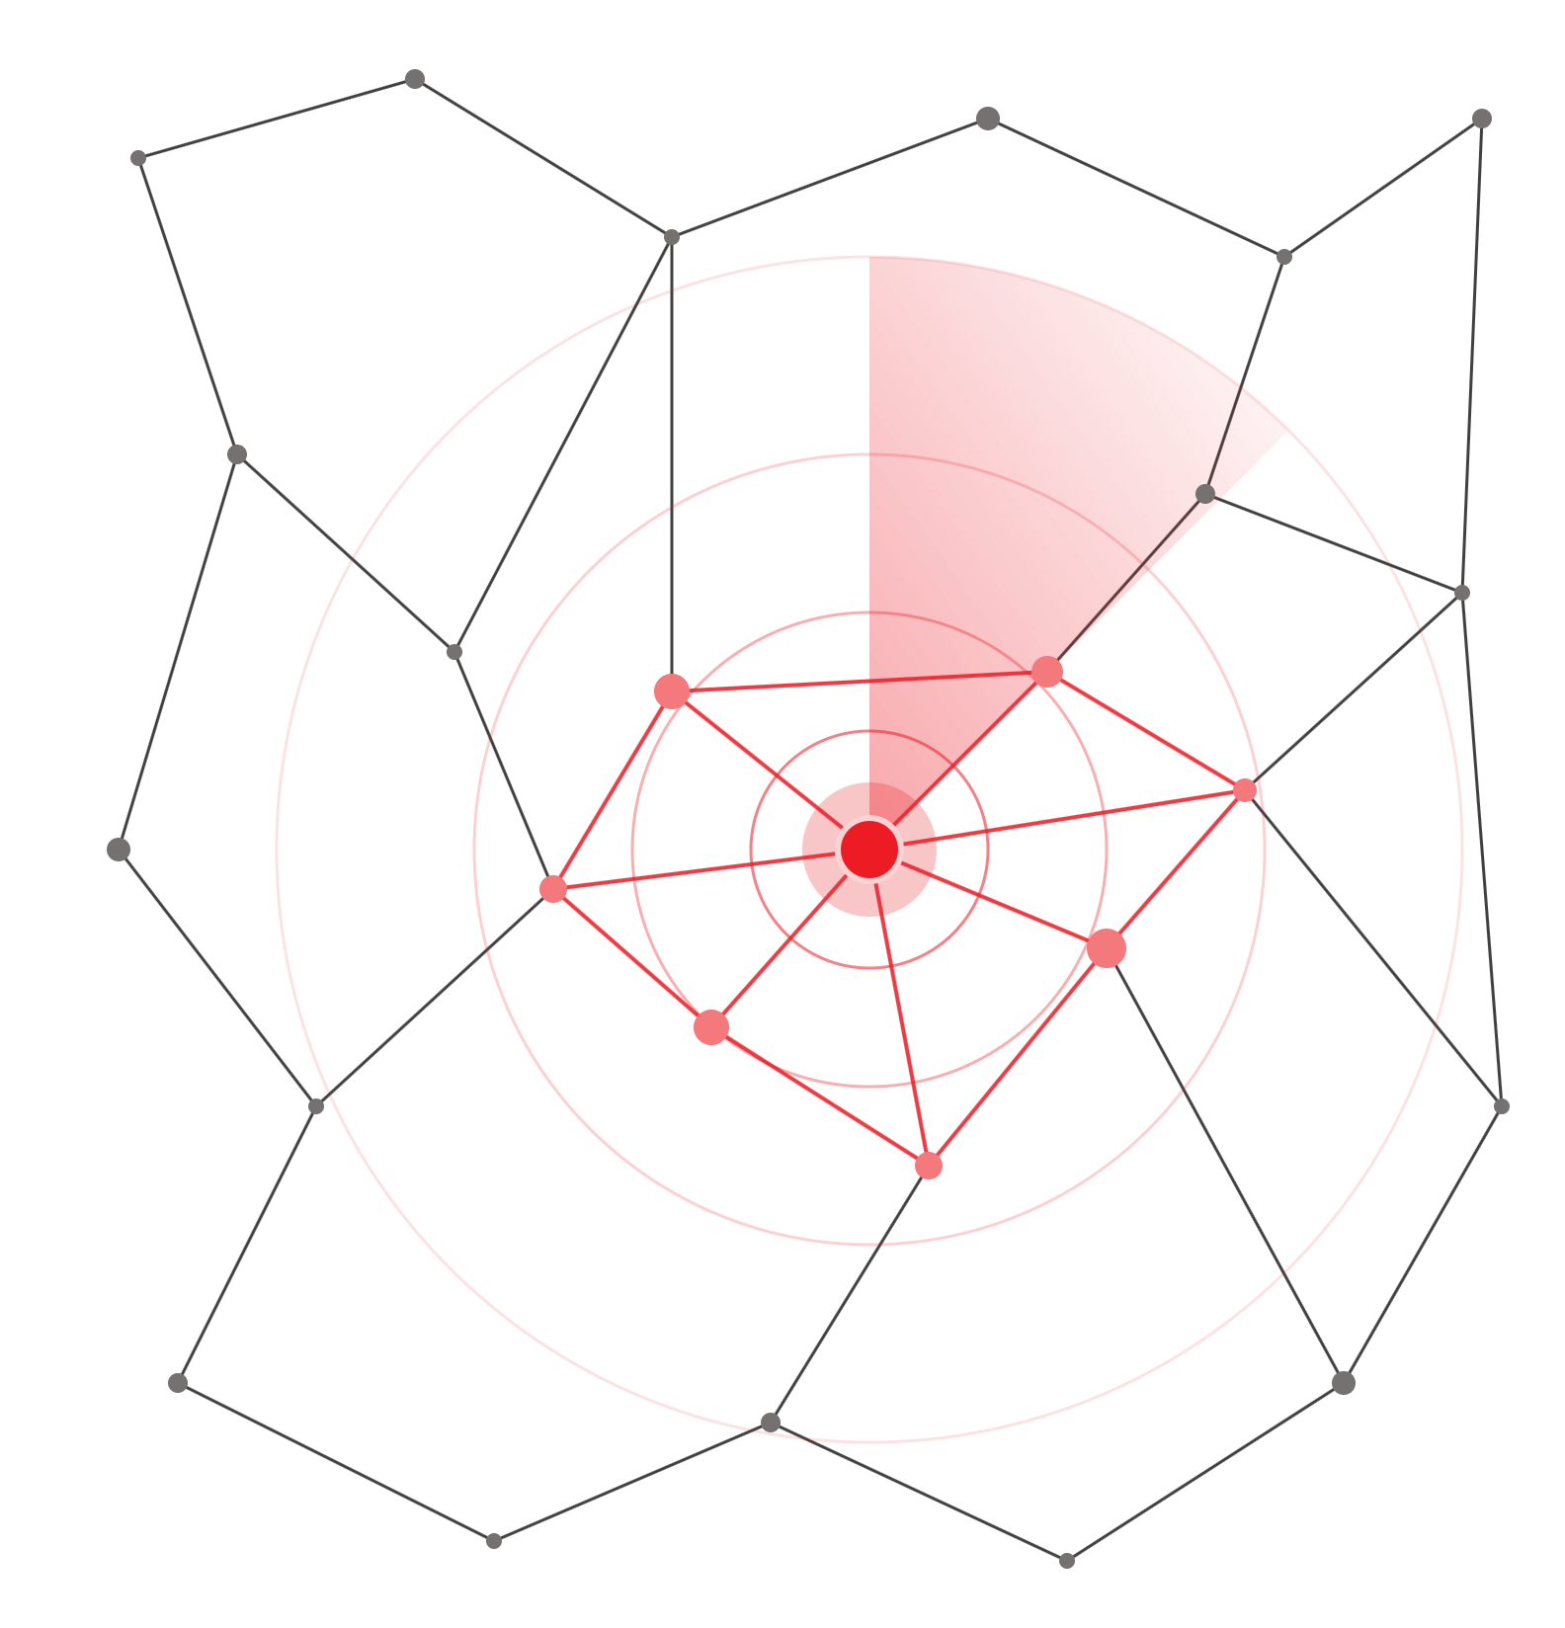
ClaimIQ
EMERGING RISK DETECTOR
AI Agent for Emerging Risk
and Fraud Discovery
Detect the unknown. Explain the signal.
Trigger early action.
DISCOVER
EXPLAIN
ACT
Solution proposal · October 2026
Notes:
ClaimIQ is an AI Agent that helps the bank detect emerging fraud and risk patterns that existing rules and models were never trained to recognise. In the next few minutes: why current controls miss emerging risk, how ClaimIQ discovers, explains and acts, what it takes to build, the value we expect from a pilot, and how we would measure it. The three words to remember: Discover, Explain, Act.

Slide 2
A discovery layer that finds emerging fraud before it becomes a material loss
EXECUTIVE SUMMARY
ClaimIQ complements, not replaces, the bank's existing rules and supervised models.
01
02
03
Discover
Explain
Act
Unseen patterns and hidden clusters
Evidence, impact and risk narrative
Early warning and investigation trigger
30–50%
20–30%
Days
PILOT TARGETS*
less initial alert-analysis time
less low-priority alert workload
to identify an emerging fraud pattern, not weeks or months
*Directional pilot targets; to be validated against the bank's current baseline.
02
Notes:
Core proposition: ClaimIQ complements existing rules and supervised models with a continuous discovery layer designed to identify unknown and emerging fraud patterns before they become material losses. It does not replace current Risk models. Three pillars. Discover: unseen patterns and hidden clusters. Explain: evidence, impact and risk narrative. Act: early warning and investigation trigger. Pilot targets (directional, to be validated against the bank's current baseline): 30–50% reduction in initial alert-analysis time through automated evidence aggregation and summarisation; 20–30% reduction in low-priority alert workload through anomaly ranking and graph context; time to identify an emerging fraud pattern reduced from weeks or months to days.

Slide 3

Built for known patterns, slow to adapt
THE PROBLEM
ALREADY COVERED BY AML AND MONITORING
HOW MODELS LEARN TODAY
Rapid fund movement
Historical data
Confirmed fraud cases
Sudden activity in dormant accounts
Predefined rules
Known risk indicators
Deviation from peer behaviour
Concentration or dispersion of transactions
They can respond too slowly when behaviour, fraud techniques, products and channels evolve
Unusual sender–beneficiary links
All of them rely on logic, thresholds and patterns that have already been defined.
New variants can appear before enough confirmed cases exist to train on.
ClaimIQ · Emerging Risk and Fraud Discovery
03
Notes:
Current Risk and Fraud models are built mainly on historical data, confirmed fraud cases, predefined rules and known risk indicators. That works well for familiar behaviour. Our AML and transaction-monitoring systems already cover many recognised scenarios: rapid fund movement, sudden activity in dormant accounts, deviation from peer behaviour, concentration or dispersion of transactions, and unusual links between senders and beneficiaries. The limitation: every one of these scenarios depends on logic, thresholds and behavioural patterns that have already been defined. When customer behaviour, transaction patterns, fraud techniques, products and digital channels evolve, these controls can respond too slowly.

Slide 4

Six gaps ClaimIQ is built to close
THE GAP TO SOLVE
01
Never-seen patterns
02
New variants
03
Coordinated behaviour
Fraud patterns that have never appeared before or are not yet labelled.
New variants of known methods, before enough confirmed cases exist to train on.
Coordination across customers, accounts, devices and counterparties.
04
Trend, not noise
05
Early warning
06
Evidence to act
Separate isolated anomalies from an emerging, expanding risk trend.
Warn before a pattern becomes material financial or operational loss.
Explain why a signal matters, with evidence an analyst can investigate.
FROM · REACTIVE RISK MANAGEMENT
TO · PROACTIVE RISK DISCOVERY
Controls respond to known typologies
Find emerging risk and intervene early
ClaimIQ · Emerging Risk and Fraud Discovery
04
Notes:
The gap to solve, in six points: 1. Detect fraud patterns that have never appeared before or have not yet been labelled. 2. Identify new variants of known fraud methods before sufficient confirmed cases exist for supervised model training. 3. Discover coordinated behaviour across customers, accounts, devices and counterparties. 4. Distinguish isolated anomalies from an emerging and expanding risk trend. 5. Provide early warning before a pattern develops into material financial or operational loss. 6. Explain why a signal matters and present sufficient evidence for a Risk Analyst to investigate. The strategic shift: move from reactive risk management, where controls respond to known typologies, to proactive risk discovery and early intervention.

Slide 5
Five capabilities, one continuous loop
THE SOLUTION
CONTINUOUSLY ANALYSES
Transactions
Customer behaviour
Accounts
Devices
Channels
Relationships
Investigation outcomes
DISCOVER
EXPLAIN
ACT
01
02
03
04
05
Detect
Connect
Discover
Explain
Act
Anomalous behaviour, no fraud labels needed
Hidden networks and clusters via graph analytics
Emerging patterns, sized and typed for experts
AI Agent builds the evidence and risk narrative
Early warning, case creation, human decision
Analyst decisions feed the next learning cycle
ClaimIQ · Emerging Risk and Fraud Discovery
05
Notes:
ClaimIQ is an enterprise AI-enabled discovery system. It continuously analyses transactions, customer behaviour, accounts, devices, channels, relationships and investigation outcomes, and combines anomaly detection, behavioural analytics, graph analytics and an AI Agent. Five integrated capabilities: 1. Detect anomalous behaviour without requiring fraud labels. 2. Discover new risk networks and hidden clusters with graph analytics. 3. Discover emerging fraud patterns automatically: cluster, size and propose a candidate typology for expert validation. 4. AI Agent for explanation and investigation support. 5. Action trigger with human-in-the-loop control. Steps 1 to 3 are the Discover pillar, step 4 is Explain, step 5 is Act. Analyst decisions and investigation outcomes are captured and feed the next learning cycle, so detection keeps improving.

Slide 6



Three engines that detect the unknown
DISCOVER
Anomalies
Networks
Emerging patterns
No fraud labels required
Graph analytics
Automatic pattern discovery
Adaptive baselines per customer, segment and peer group
Links customers, accounts, devices, beneficiaries and fund flows
Clusters unusual events and finds their shared traits
Flags shifts in frequency, value, timing, channel or counterparty
Exposes shared devices and circular, layered or dispersed flows
Measures growth and spread; sizes customers and value affected
Combines rare signals across dimensions, not one threshold
Finds coordinated groups even when each account looks normal
Proposes candidate typologies and new rules for expert validation
ClaimIQ · Emerging Risk and Fraud Discovery
06
Notes:
Anomalies, without fraud labels: build an adaptive behavioural baseline for each customer, segment and peer group; detect sudden changes in transaction frequency, value, timing, channel or counterparty; identify behaviour that deviates from the customer's own history or from comparable peers; surface rare combinations of signals not encoded in any existing rule; combine anomalies across multiple data dimensions to reduce reliance on a single threshold. Networks, via graph analytics: link customers, accounts, devices, addresses, phone numbers, beneficiaries and fund flows. This reveals multiple accounts sharing a device or identity attribute; circular, layered or rapidly dispersed fund flows; collector, intermediary and distribution accounts; groups acting in coordination although individual accounts appear normal; and new entities connecting to an existing high-risk network. Emerging patterns, automatically: cluster similar unusual events and identify their shared characteristics; measure growth rate, persistence and geographic or channel spread; estimate the number of customers and transaction value potentially affected; propose a candidate fraud typology for expert validation; recommend new rules, features or model improvements.

Slide 7
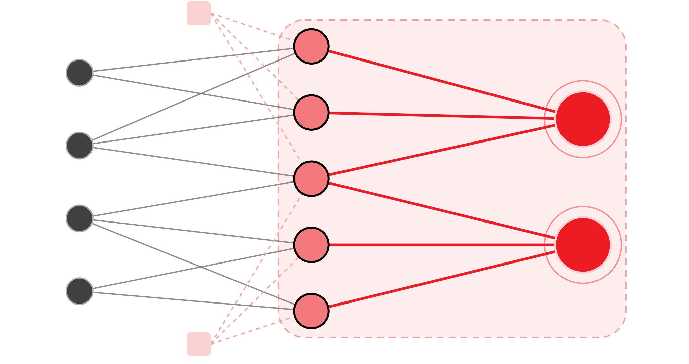



Hidden below every individual threshold
ILLUSTRATIVE EXAMPLE
WHAT EACH ALERT SEES
Funding sources
Newly opened accounts
Intermediary accounts
Every newly opened account stays below its individual alert threshold.
Shared device
WHAT CLAIMIQ SEES
Shared devices
Multiple funding sources
Rapid transfers to a small intermediary network
One coordinated pattern, surfaced for investigation before it scales.
Shared device
Pattern surfaced by ClaimIQ
Illustrative scenario, not a real case.
07
Notes:
Illustrative example from the proposal: a group of newly opened accounts may each remain below individual alert thresholds, so no single rule fires. ClaimIQ looks at the network instead: it identifies shared devices, multiple funding sources and rapid transfers to a small network of intermediary accounts. Seen together, these signals form one coordinated pattern that can be routed to an analyst before it scales. This is a scenario to show the mechanism, not a real case or a measured result.

Slide 8



Explained alerts, human decisions
EXPLAIN AND ACT
04 · EXPLAIN
05 · ACT
CONTROL PRINCIPLE
Agent explains
Early action
Humans decide
What is unusual, and which baseline was breached
Early warning to the relevant Fraud or Risk Analyst
Final decisions remain with authorised Risk specialists.
Customers, accounts, transactions and links involved
Creates or enriches a case in existing case management
The AI supports discovery, prioritisation and investigation. It does not independently conclude fraud or make adverse customer decisions.
When the signal began and how it is evolving
Prioritised by confidence, estimated loss and network reach
Severity, exposure, and which rule or model missed it
Recommends rules, features or enhanced surveillance
Supporting evidence and recommended next steps
Captures analyst decisions for the next learning cycle
ClaimIQ · Emerging Risk and Fraud Discovery
08
Notes:
Explain. For every signal the AI Agent explains what is unusual and which baseline was breached; identifies the customers, accounts, transactions and relationships involved; shows when the signal first appeared and how it is evolving; estimates severity and potential exposure; explains which existing rule or model failed to capture the pattern; and presents supporting evidence with recommended investigation actions. Act. ClaimIQ sends an early warning to the relevant Fraud or Risk Analyst; creates or enriches an investigation case in the existing case-management system; prioritises alerts by confidence, estimated loss and network reach; recommends a monitoring rule, fraud feature or enhanced-surveillance action; and captures analyst decisions and investigation outcomes for the next learning cycle. Control principle, which is non-negotiable: final decisions remain with authorised Risk specialists. The AI supports discovery, prioritisation and investigation, but does not independently conclude fraud or make adverse customer decisions.

Slide 9



Data, platform and people
WHAT IT TAKES
Data
Platform
People
Near-real-time transactions
Lakehouse and feature store
Fraud, FinCrime Risk SMEs
Customer profile, KYC, rating
Streaming pipelines
Data Scientists, ML Engineers
Accounts, products, channels
Anomaly, peer-group analytics
Data and Graph Engineers
Counterparties, relationships
Graph database or engine
Model Validation, MRM
Device, IP, session signals
Governed LLM with retrieval
InfoSec, Data Governance
Alerts, cases and outcomes
Model registry, monitoring
Legal and Compliance
Fraud labels, trusted lists
AML, Fraud, Case APIs
AML, Fraud investigators
Permitted external data
Access control, audit trail
Integration teams
SPECIALIST MODEL
A medium-sized, in-house LLM post-trained on approved, anonymised data for fraud reasoning and alert summaries, to control accuracy, explainability, latency, privacy and cost.
ClaimIQ · Emerging Risk and Fraud Discovery
09
Notes:
Data: near-real-time transaction data; customer profile, segmentation, KYC information and risk rating; accounts, products, channels and counterparties; device ID, IP address, session and authentication signals, subject to policy; relationship data linking customers, accounts and related entities; historical alerts, cases, investigation results and confirmed losses; fraud labels, blacklists, whitelists, skip lists and trusted pairs where available; permitted external data such as watchlists, adverse-media indicators or market events. Platform: enterprise Data Lake or Lakehouse with a governed feature store; streaming or near-real-time pipelines; unsupervised and semi-supervised anomaly detection with behavioural and peer-group analysis; a graph database or graph-processing engine; a governed LLM with controlled retrieval of data and evidence; model registry, validation, monitoring and drift detection; APIs to AML, Fraud and Case Management platforms; role-based access, masking, encryption and a full audit trail. People and governance: Fraud and Financial Crime Risk SMEs; Data Scientists, ML Engineers, Data Engineers and Graph Engineers; Risk Model Validation and Model Risk Management; Information Security, Data Governance, Legal and Compliance; AML and Fraud investigators; AML, Fraud and Case Management integration teams. Specialist model: a medium-sized, internally deployed language model can be post-trained on approved and anonymised domain data for fraud reasoning, alert summarisation and investigation assistance. A specialist model is preferable where accuracy, explainability, latency, privacy and cost must be controlled.

Slide 10
Faster analysis, earlier detection
EXPECTED VALUE · PILOT TARGETS*
30–50%
less initial alert-analysis time
INVESTMENT AREAS
Automated evidence aggregation and summarisation
01
Data engineering and system integration
20–30%
02
Graph and streaming infrastructure
less low-priority alert workload
03
Model development, post-training and validation
Anomaly ranking plus graph context
04
Information security and model governance
Days
05
Change management and user training
to identify an emerging pattern
Down from weeks or months
06
Ongoing compute, storage and support
Risk coverage
Analyst capacity
Loss exposure
Higher detection of previously unknown or weakly signalled patterns
More cases handled without proportional headcount growth
Earlier warning and intervention before a pattern scales
*Directional pilot targets; to be validated against the bank's current baseline.
10
Notes:
Pilot benefit targets. These are directional and must be validated against the bank's current baseline before we commit to them. - Initial alert-analysis time: 30–50% reduction, through automated evidence aggregation and summarisation. - Low-priority alert workload: 20–30% reduction, through anomaly ranking and graph context. - Time to identify an emerging fraud pattern: from weeks or months to days. - Risk coverage: higher detection of previously unknown or weakly signalled patterns. - Analyst capacity: more cases handled without proportional headcount growth. - Expected loss exposure: earlier warning and intervention before a pattern scales. Qualitative benefits: detect unknown fraud outside current rule coverage; adapt faster as behaviours and channels evolve; reduce dependence on waiting for many confirmed cases before retraining; clearer explanations and traceable evidence per alert; move Risk teams from isolated alerts to network-level pattern discovery; a continuous feedback loop across detection, investigation, validation and model enhancement. Principal cost components: data engineering and integration with source and case-management systems; graph and streaming infrastructure; model development, post-training, validation and monitoring; information-security controls and model governance; change management, user training and operating-model redesign; ongoing compute, storage and support.

Slide 11

Start focused, scale enterprise-wide
PILOT AND SCALE
STAGE 1
STAGE 2
LONGER TERM
Initial pilot
Expansion
Enterprise layer
Fraud Risk · Financial Crime and AML · Card and Payment Risk · Digital Banking Risk · Transaction Monitoring
Retail and Corporate Banking · Wealth Management · Lending and Credit Risk · Operations and Contact Centre · Cybersecurity and account takeover · Enterprise Risk
One discovery layer for emerging risk across customers, transactions, portfolios, operations, digital channels and external events
RECOMMENDED PILOT KPIS
Detection quality
Speed and efficiency
Value and adoption
Recall on confirmed fraud cases
First signal to warning time
Emerging patterns validated
Precision or alert-to-case rate
Investigation time per alert
Value flagged for early review
Dollar-weighted recall
% alerts fully evidenced
False-positive rate
Analyst acceptance of AI advice
ClaimIQ · Emerging Risk and Fraud Discovery
11
Notes:
Initial pilot scope: Fraud Risk Management; Financial Crime Risk Management and AML; Card Risk and Payment Risk; Digital Banking Risk; Transaction Monitoring operations. Expansion potential: Retail Banking and Corporate Banking; Wealth Management; Lending and Credit Risk; Operations and Contact Centre; Cybersecurity and account-takeover monitoring; Enterprise Risk Management. In the longer term ClaimIQ can become an enterprise-wide discovery layer analysing emerging risks across customers, transactions, portfolios, operations, digital channels and external events. Recommended pilot KPIs (ten): recall on confirmed fraud cases; precision or alert-to-case conversion rate; dollar-weighted recall; false-positive rate; time from first signal to generated warning; average investigation time per alert; number of emerging patterns validated by experts; total transaction value identified for early review; percentage of alerts with complete evidence and explanation; analyst acceptance rate for AI recommendations.

Slide 12

“What new risk pattern is beginning to emerge, why does it matter, and what should we investigate now?”
POSITIONING
EXISTING CONTROLS ANSWER
“Does this activity match a known risk pattern?”
CLAIMIQ ANSWERS
ClaimIQ does not replace current Risk models. It adds a discovery layer that enables the bank to identify and intervene earlier.
ClaimIQ
Notes:
Close on the positioning. Existing controls answer one question: does this activity match a known risk pattern? ClaimIQ answers a different one: what new risk pattern is beginning to emerge, why does it matter, and what should we investigate now? Elevator pitch: ClaimIQ is an AI Agent that helps the bank detect emerging fraud and risk patterns that existing rules and models were never trained to recognise. It continuously analyses behaviour, transactions and relationship networks to discover unusual clusters, explain why they matter, estimate potential impact and trigger an investigation workflow. It does not replace current Risk models; it adds a discovery layer so the bank can identify and intervene earlier. Detect the unknown. Explain the signal. Trigger early action.

